Slide 1
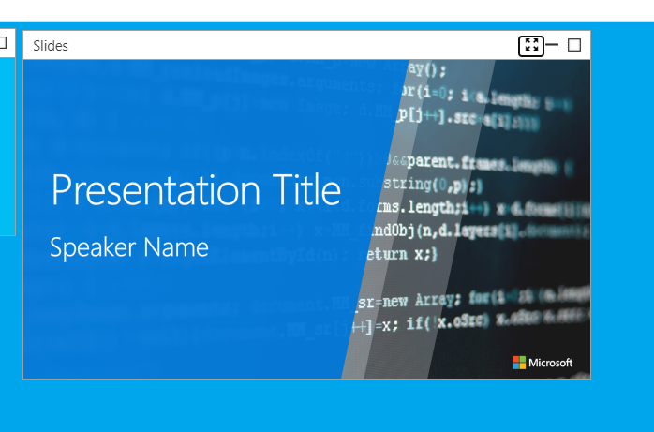









Albert Hoitingh
Sensitivity labels, now and the roadmap
@Alberthoitingh
https://linkedin.com/in/appieh
https://alberthoitingh.com

Slide 2
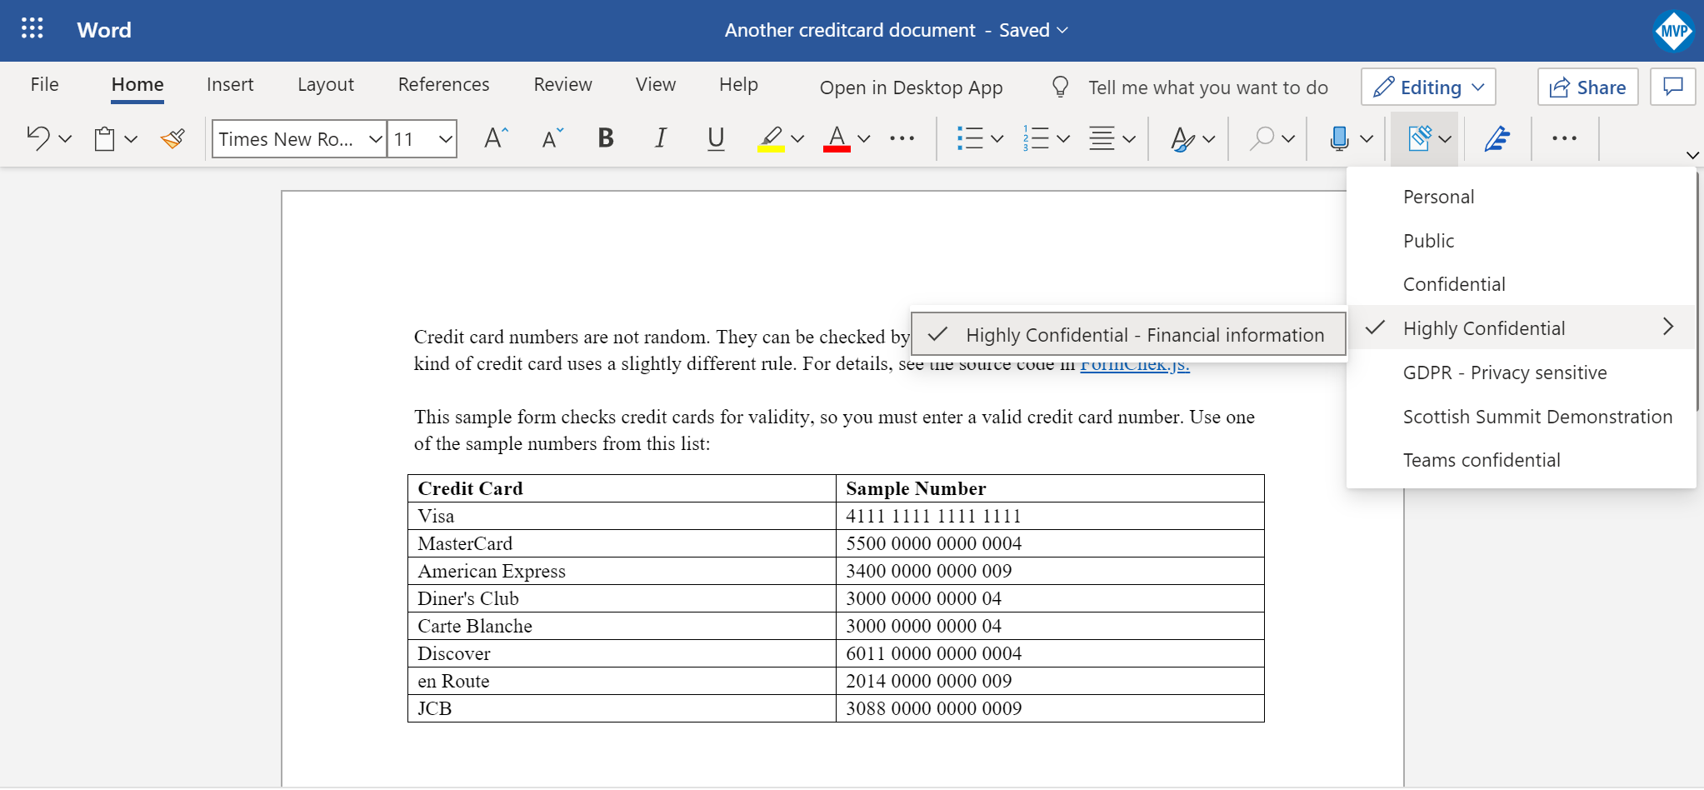

Slide 3

Let’s take a little journey
From AIP to MIP and UL

Slide 4
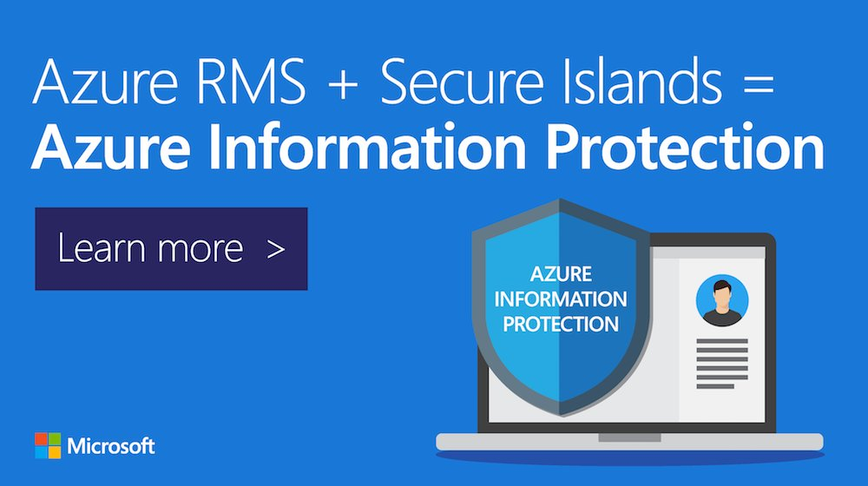
Let’s take a little journey….
Azure Information Protection
Classification & Detection
Add-in client for Office
Client for Windows Explorer
Viewer client (also mobile)
Version: 1.x (classic)
Deprecated March 31st 2021
1

Slide 5
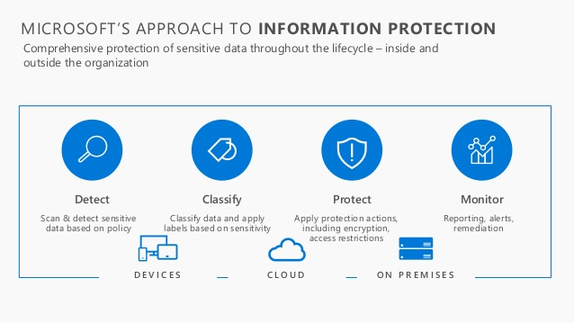
Let’s take a little journey….
Azure Information Protection
More content sources
On-premises scanner
Cloud App Security integration
Adobe integration
1
2

Slide 6
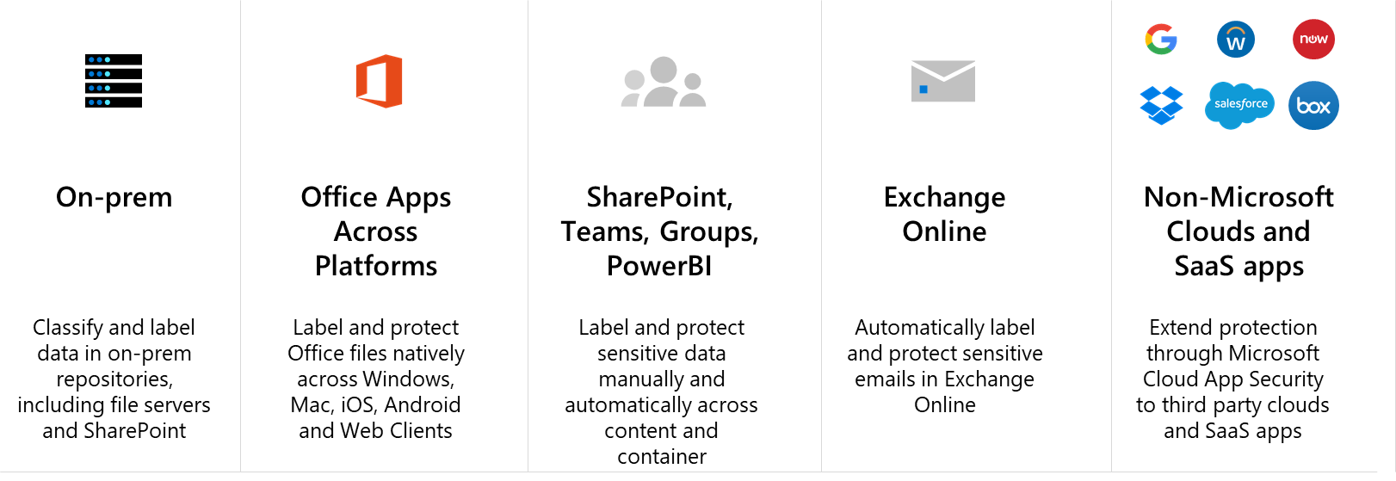
Let’s take a little journey….
Unified Labeling
One approach for sensitive information
New clients: 2.x
Native client for Office Mac, iOS and Android
Managed from S&C center
Windows Information Protection
Two types of labels in Microsoft 365!
1
2
3

Slide 7
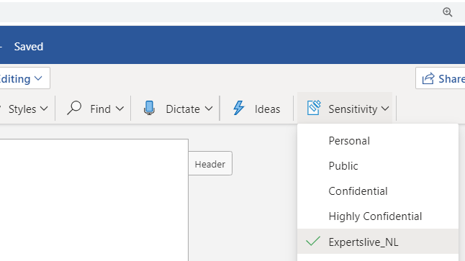
Let’s take a little journey….
Ignite previews for 2020
Office Online integration
Office Pro Plus integration
Site classifications
Auto-classification in SharePoint Online and OneDrive
Info panel in Office
1
2
3
4

Slide 8
New functions
Most are General Available (GA)

Slide 9
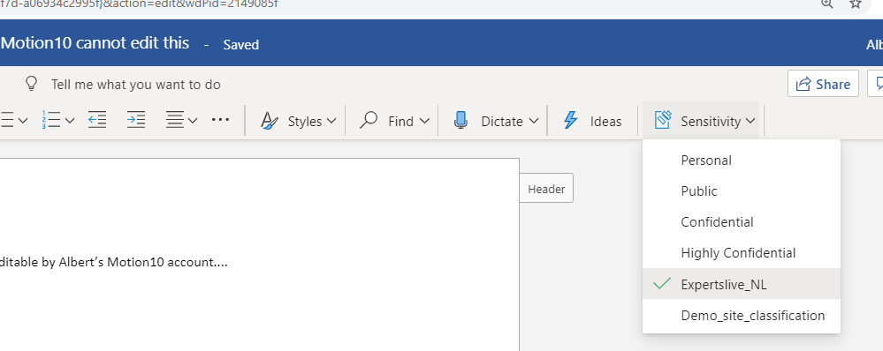
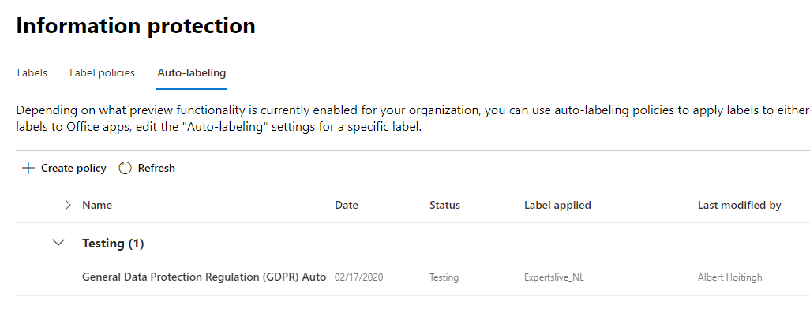
Ignite 2019 announcements
Online integration
Sensitivity Office Online
Sensitivity label as column
Note:
You cannot change a label within a library;
There’s no default label option;
Co-authoring is disabled when a classification label is used…..

Slide 10
Demo

Slide 11
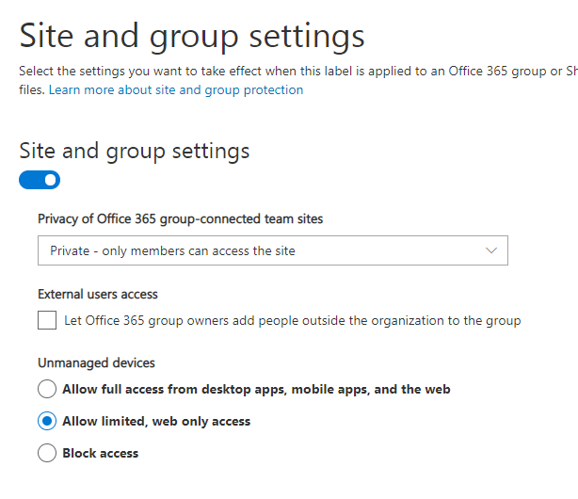
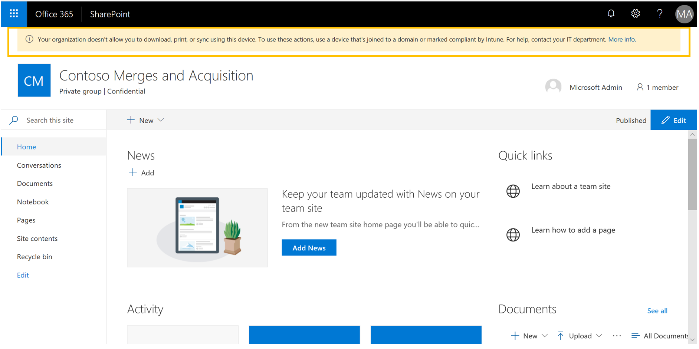
Ignite 2019 announcements
Sensitivity labels for sites/groups
Label a Team, Office Group and SharePoint site
Effects privacy, external access and device access
Does not effect documents in the Team, Group or site!
Does require an Azure AD conditional access rule

Slide 12
Demo

Slide 13
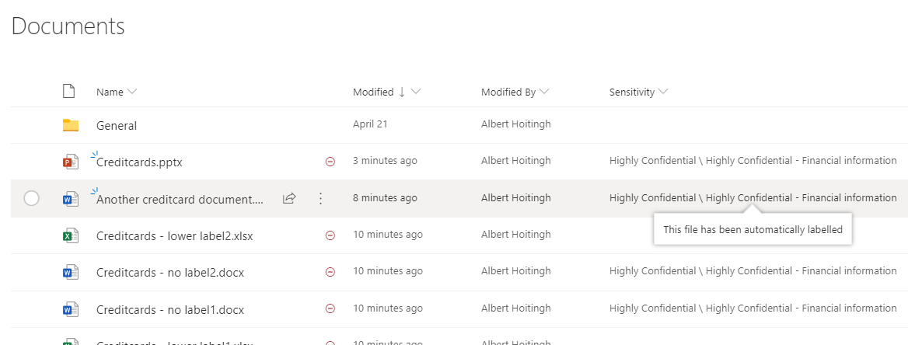
Ignite 2019 announcements
Data classification at rest
Uses the Microsoft 365 DLP engine
No need for MCAS anymore
Nice “Simulation mode”
Will take some time to become active

Slide 14
Demo

Slide 15
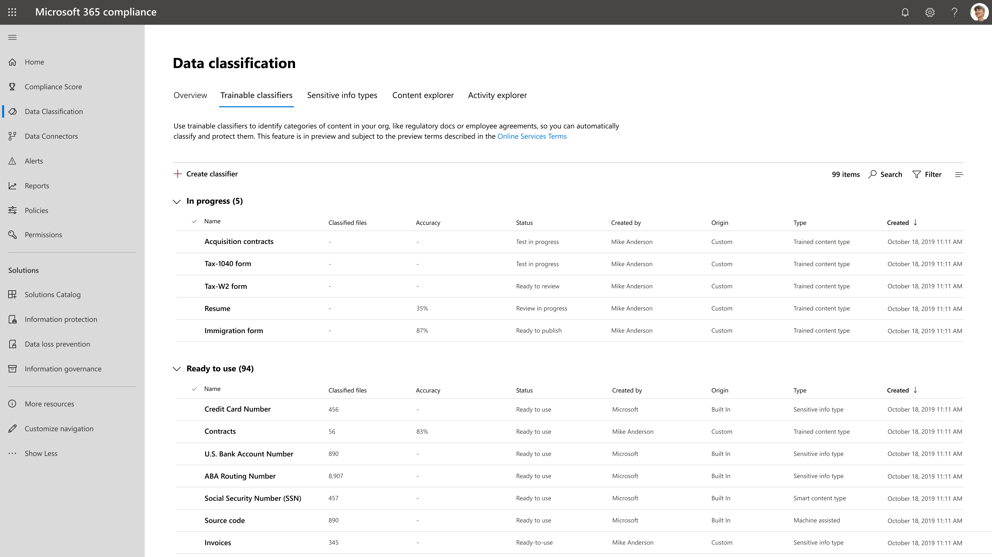
Ignite 2019 announcements
Trainable classifiers
Use Machine Teaching
Complementary to current sensitive information types
Several classifiers out of the box

Slide 16
Demo

Slide 17
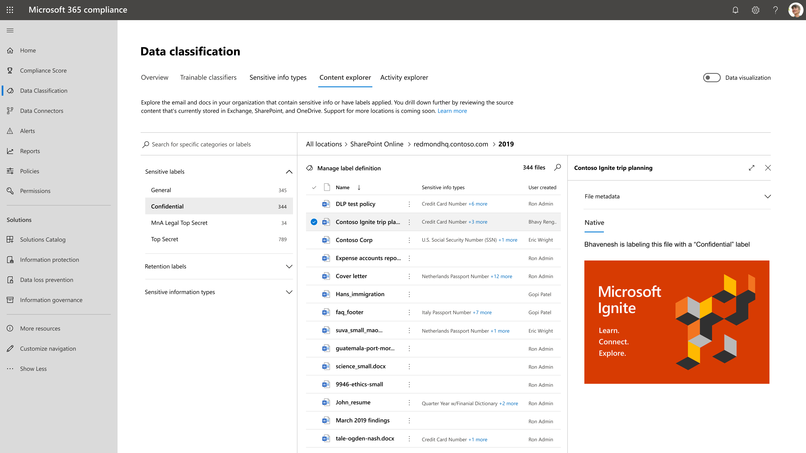
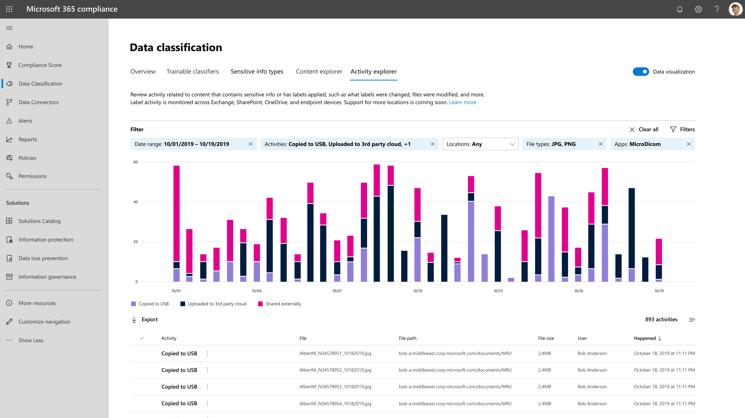
Ignite 2019 announcements
Data classification dashboard
Activity explorer
Content explorer
Trainable classifiers

Slide 18
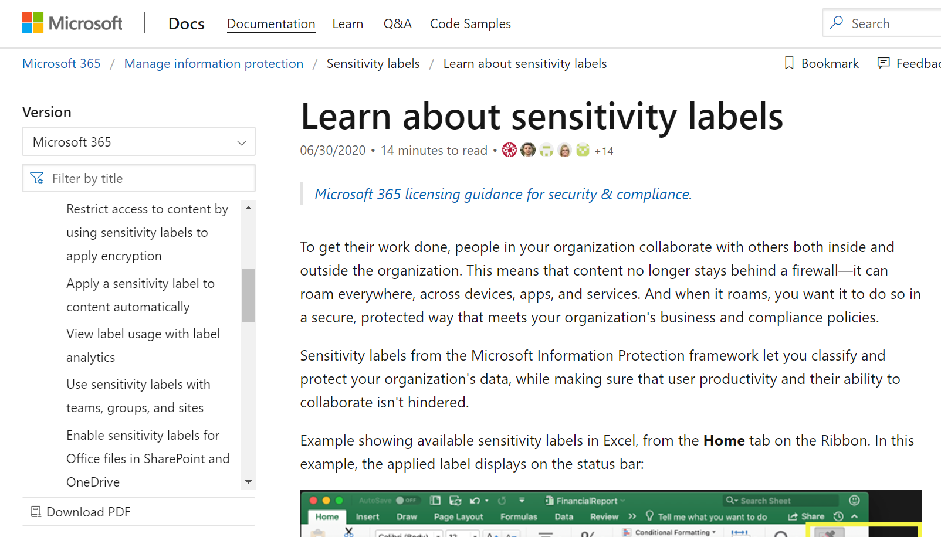
Learn more?
Relevant link:
https://docs.microsoft.com/en-us/microsoft-365/compliance/sensitivity-labels

Slide 19
Wrapping up…

Slide 20
Questions?

